Slide 1
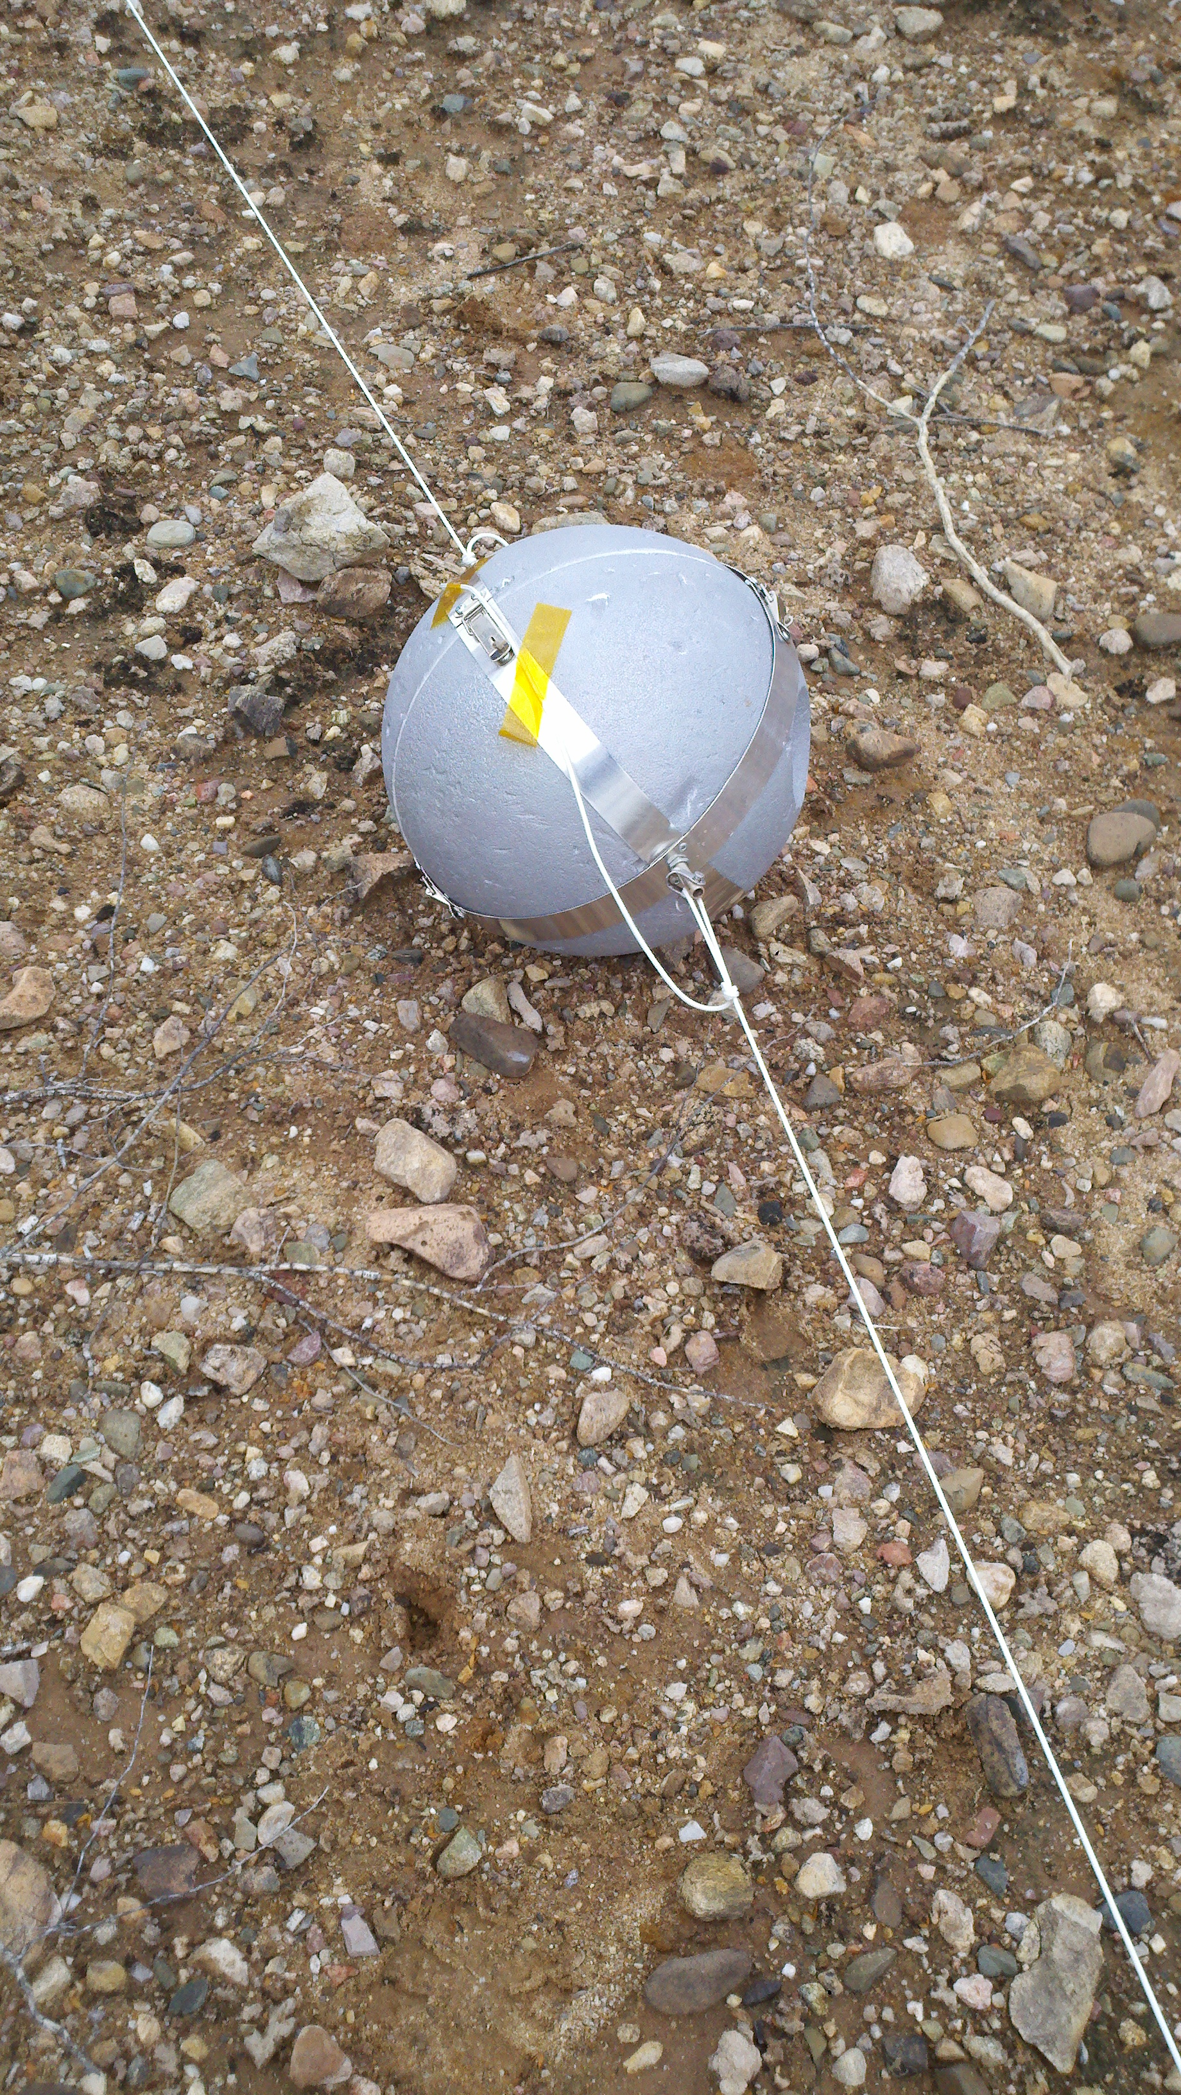
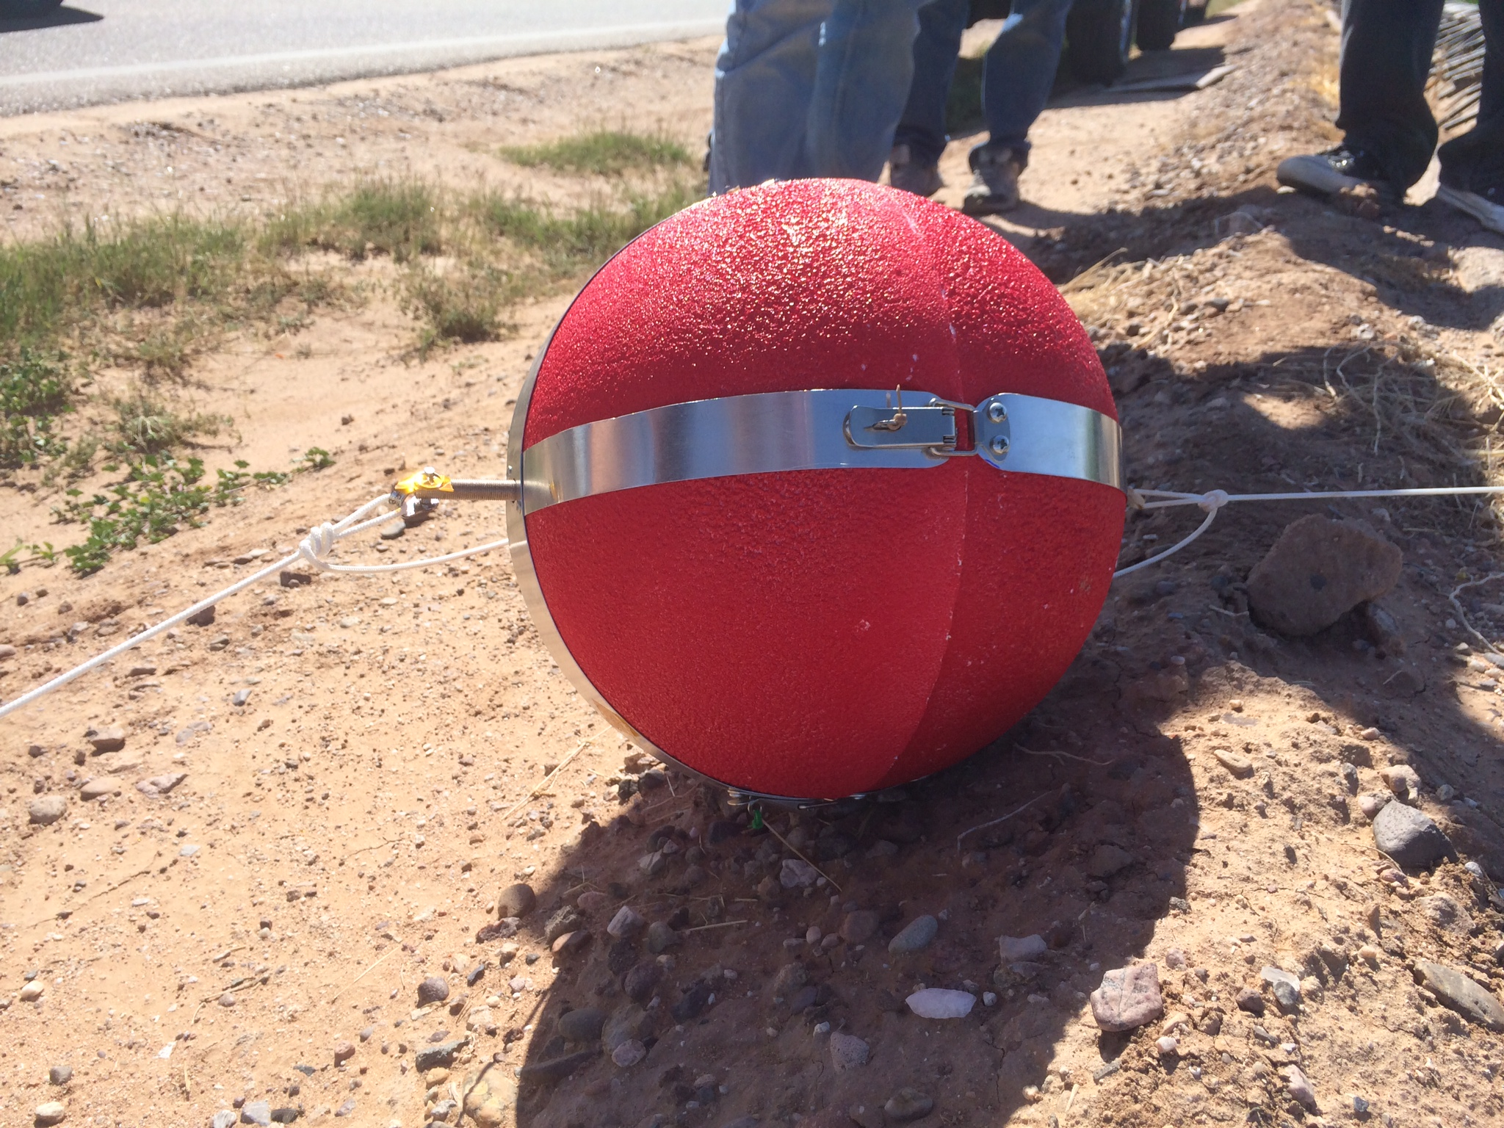



Glendale Community College
ANSR/Ascend!

Slide 2
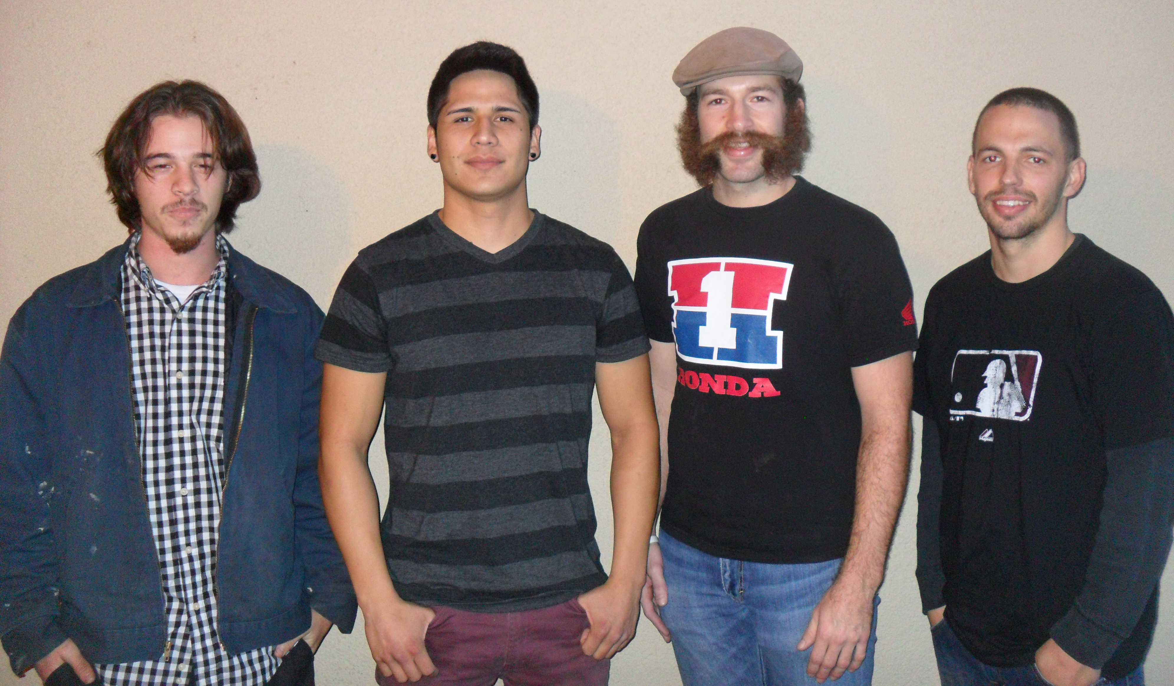
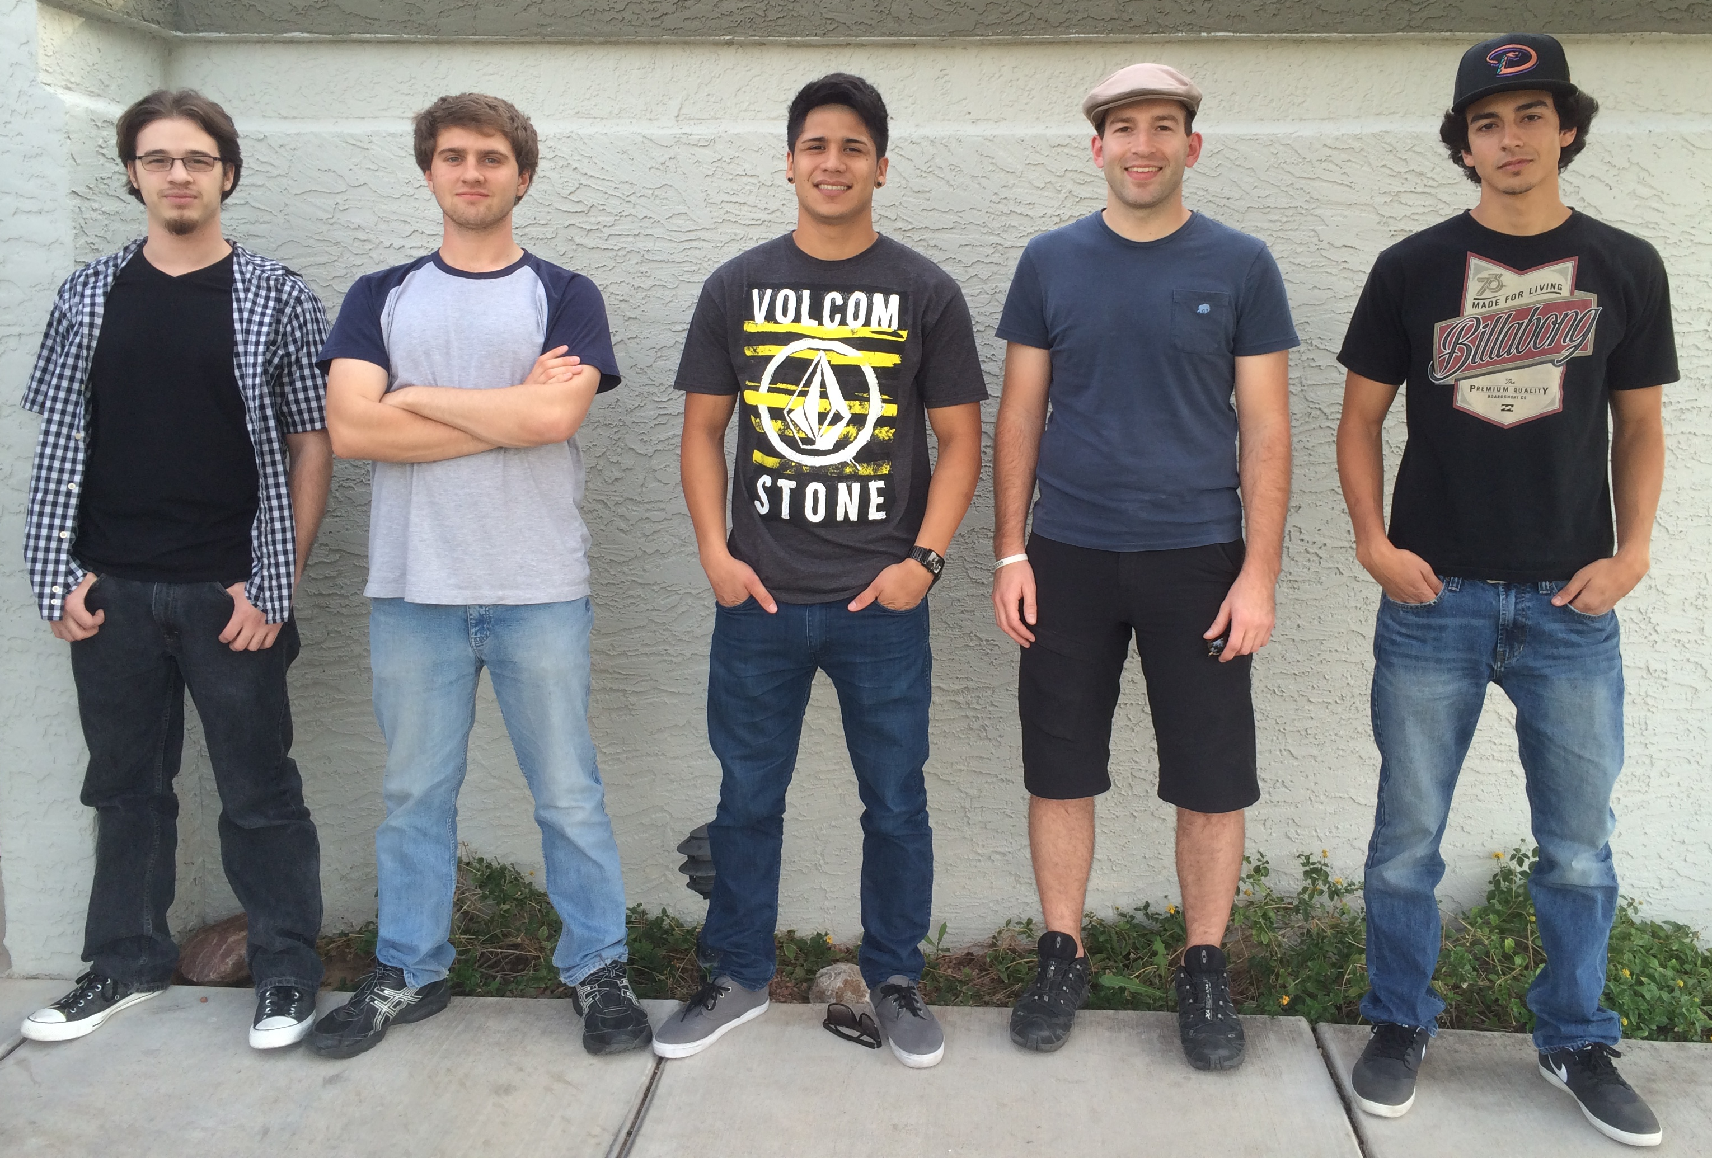
Ace of Space Fall 2013
Team Members
Zakk Diaz
Andrew Perez
Sean Holloway
Kyle Elliott
Ace of Space Spring 2014
Zakk Diaz
Nate Horney
Andrew Perez
Sean Holloway
Alex Aguayo

Slide 3
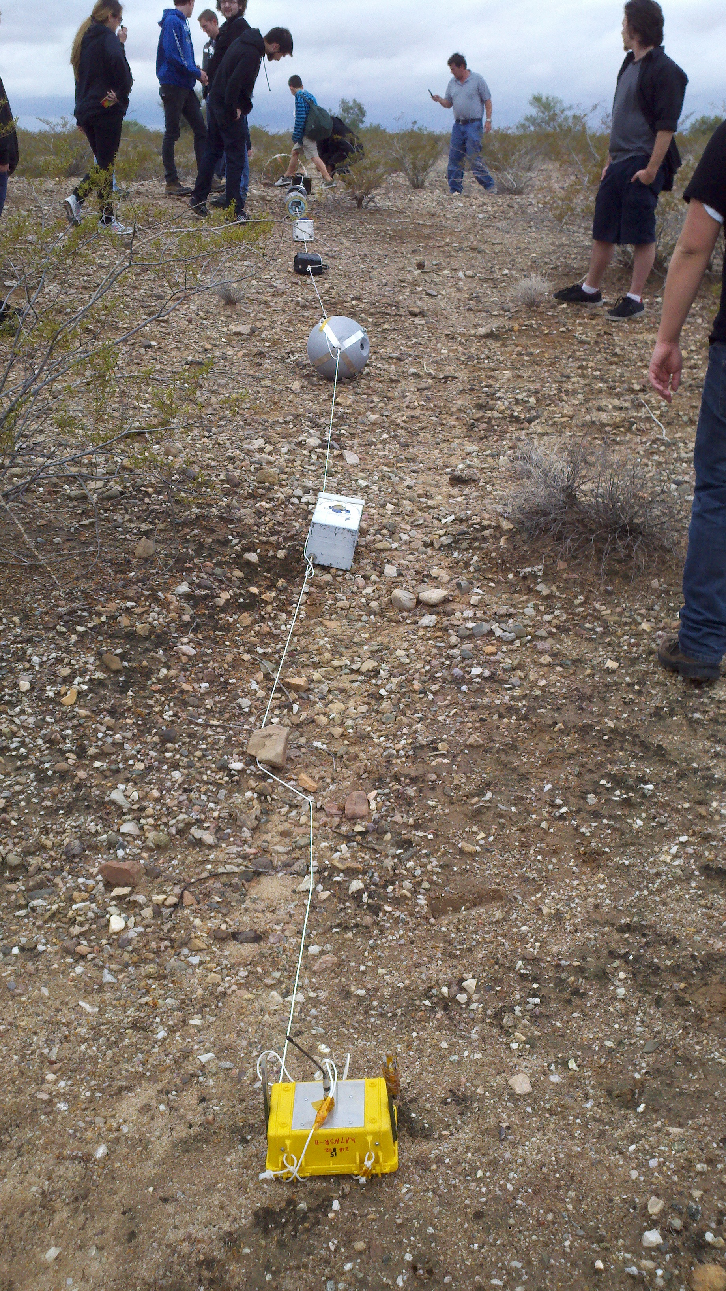
Fall 2013 Objectives
Implement the Raspberry Pi
Cost efficiency
Readily accessible materials
Simple Construction
Ease of use
Sturdiness
Reliable data recovery
Test solar panel as alternate energy
source

Slide 4
Outcomes
Fall 2013
Capsule recovered and Intact
Retrieved GoPro video of the ascend
Recovered and Recorded sensor data
Retrieved Solar Panel readings

Slide 5
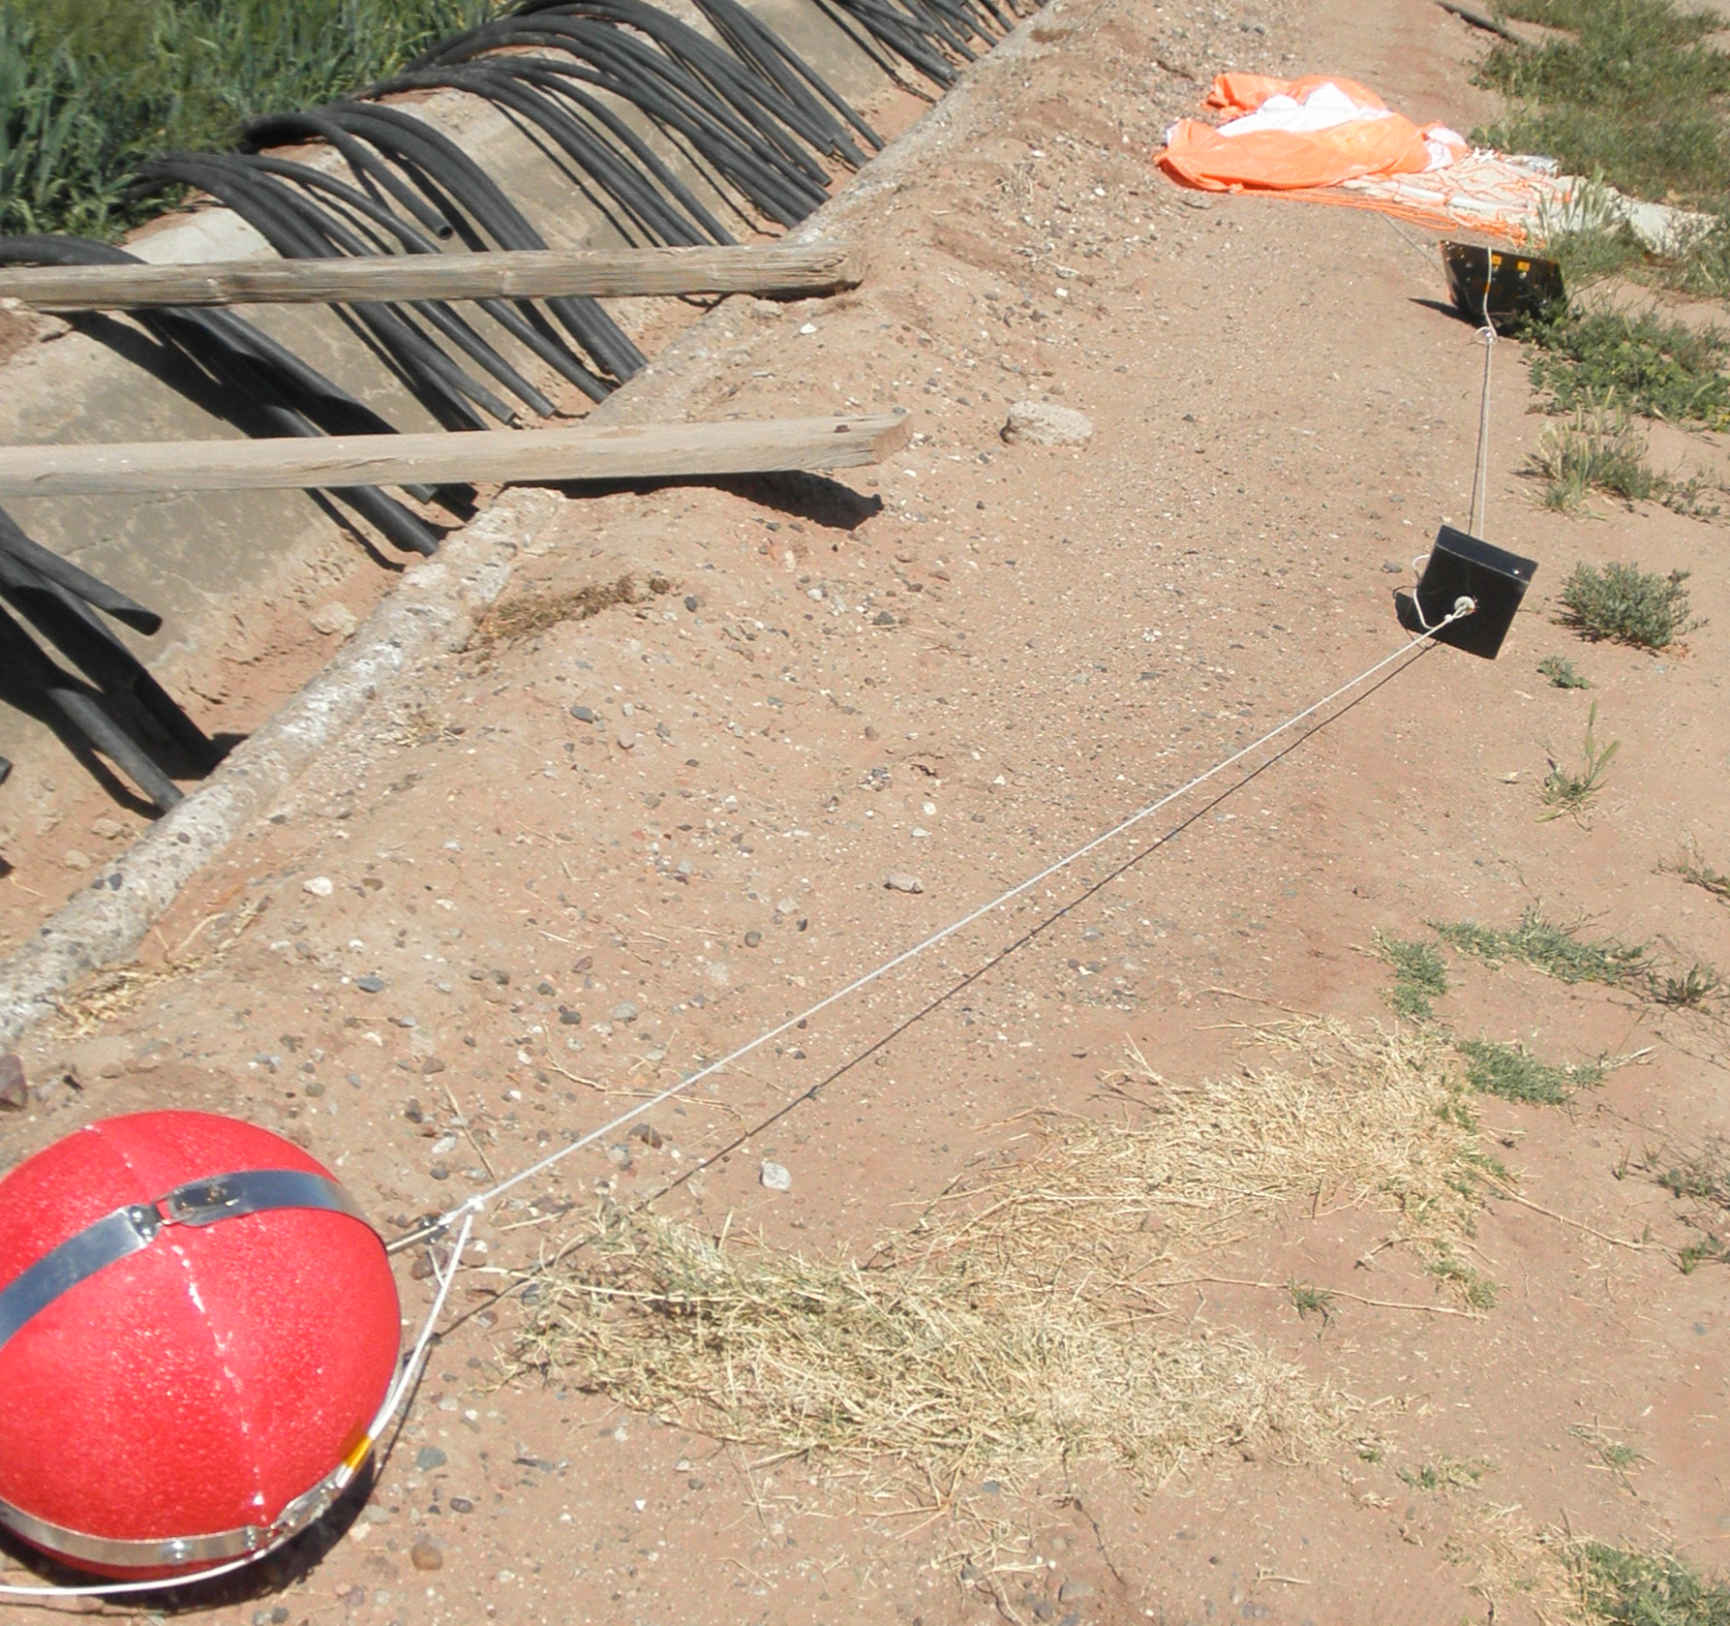
Spring 2014 Objectives
Collaboration with other departments at GCC
Controlling the GoPro using the altimeter.
Running the Raspberry Pi using SSH
Program modifications
Simple construction
Reliable data recovery

Slide 6
Outcomes
Spring 2014
Lost our daughter board during flight.
Retrieved usable data up till daughter board failure
Retrieved video of the
  landing

Slide 8
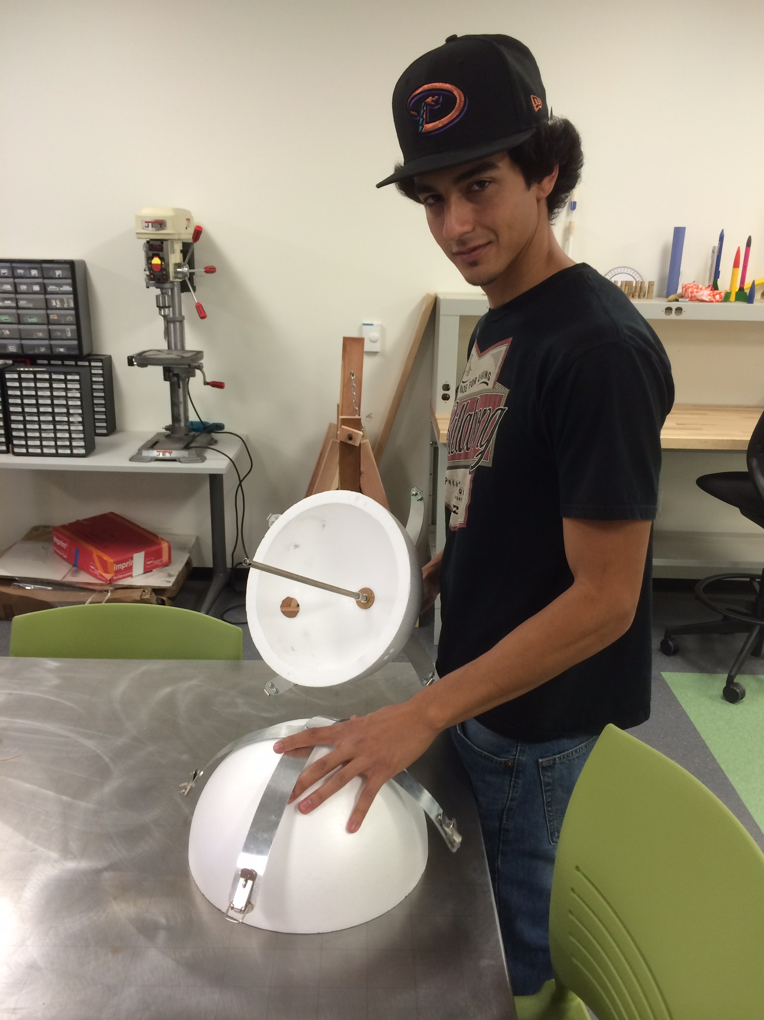
Fall/Spring Semester Structure
One 12inch hollow Styrofoam sphere
Center Board for holding components
Metal straps for easy access
Affordable and easy to find parts

Slide 9
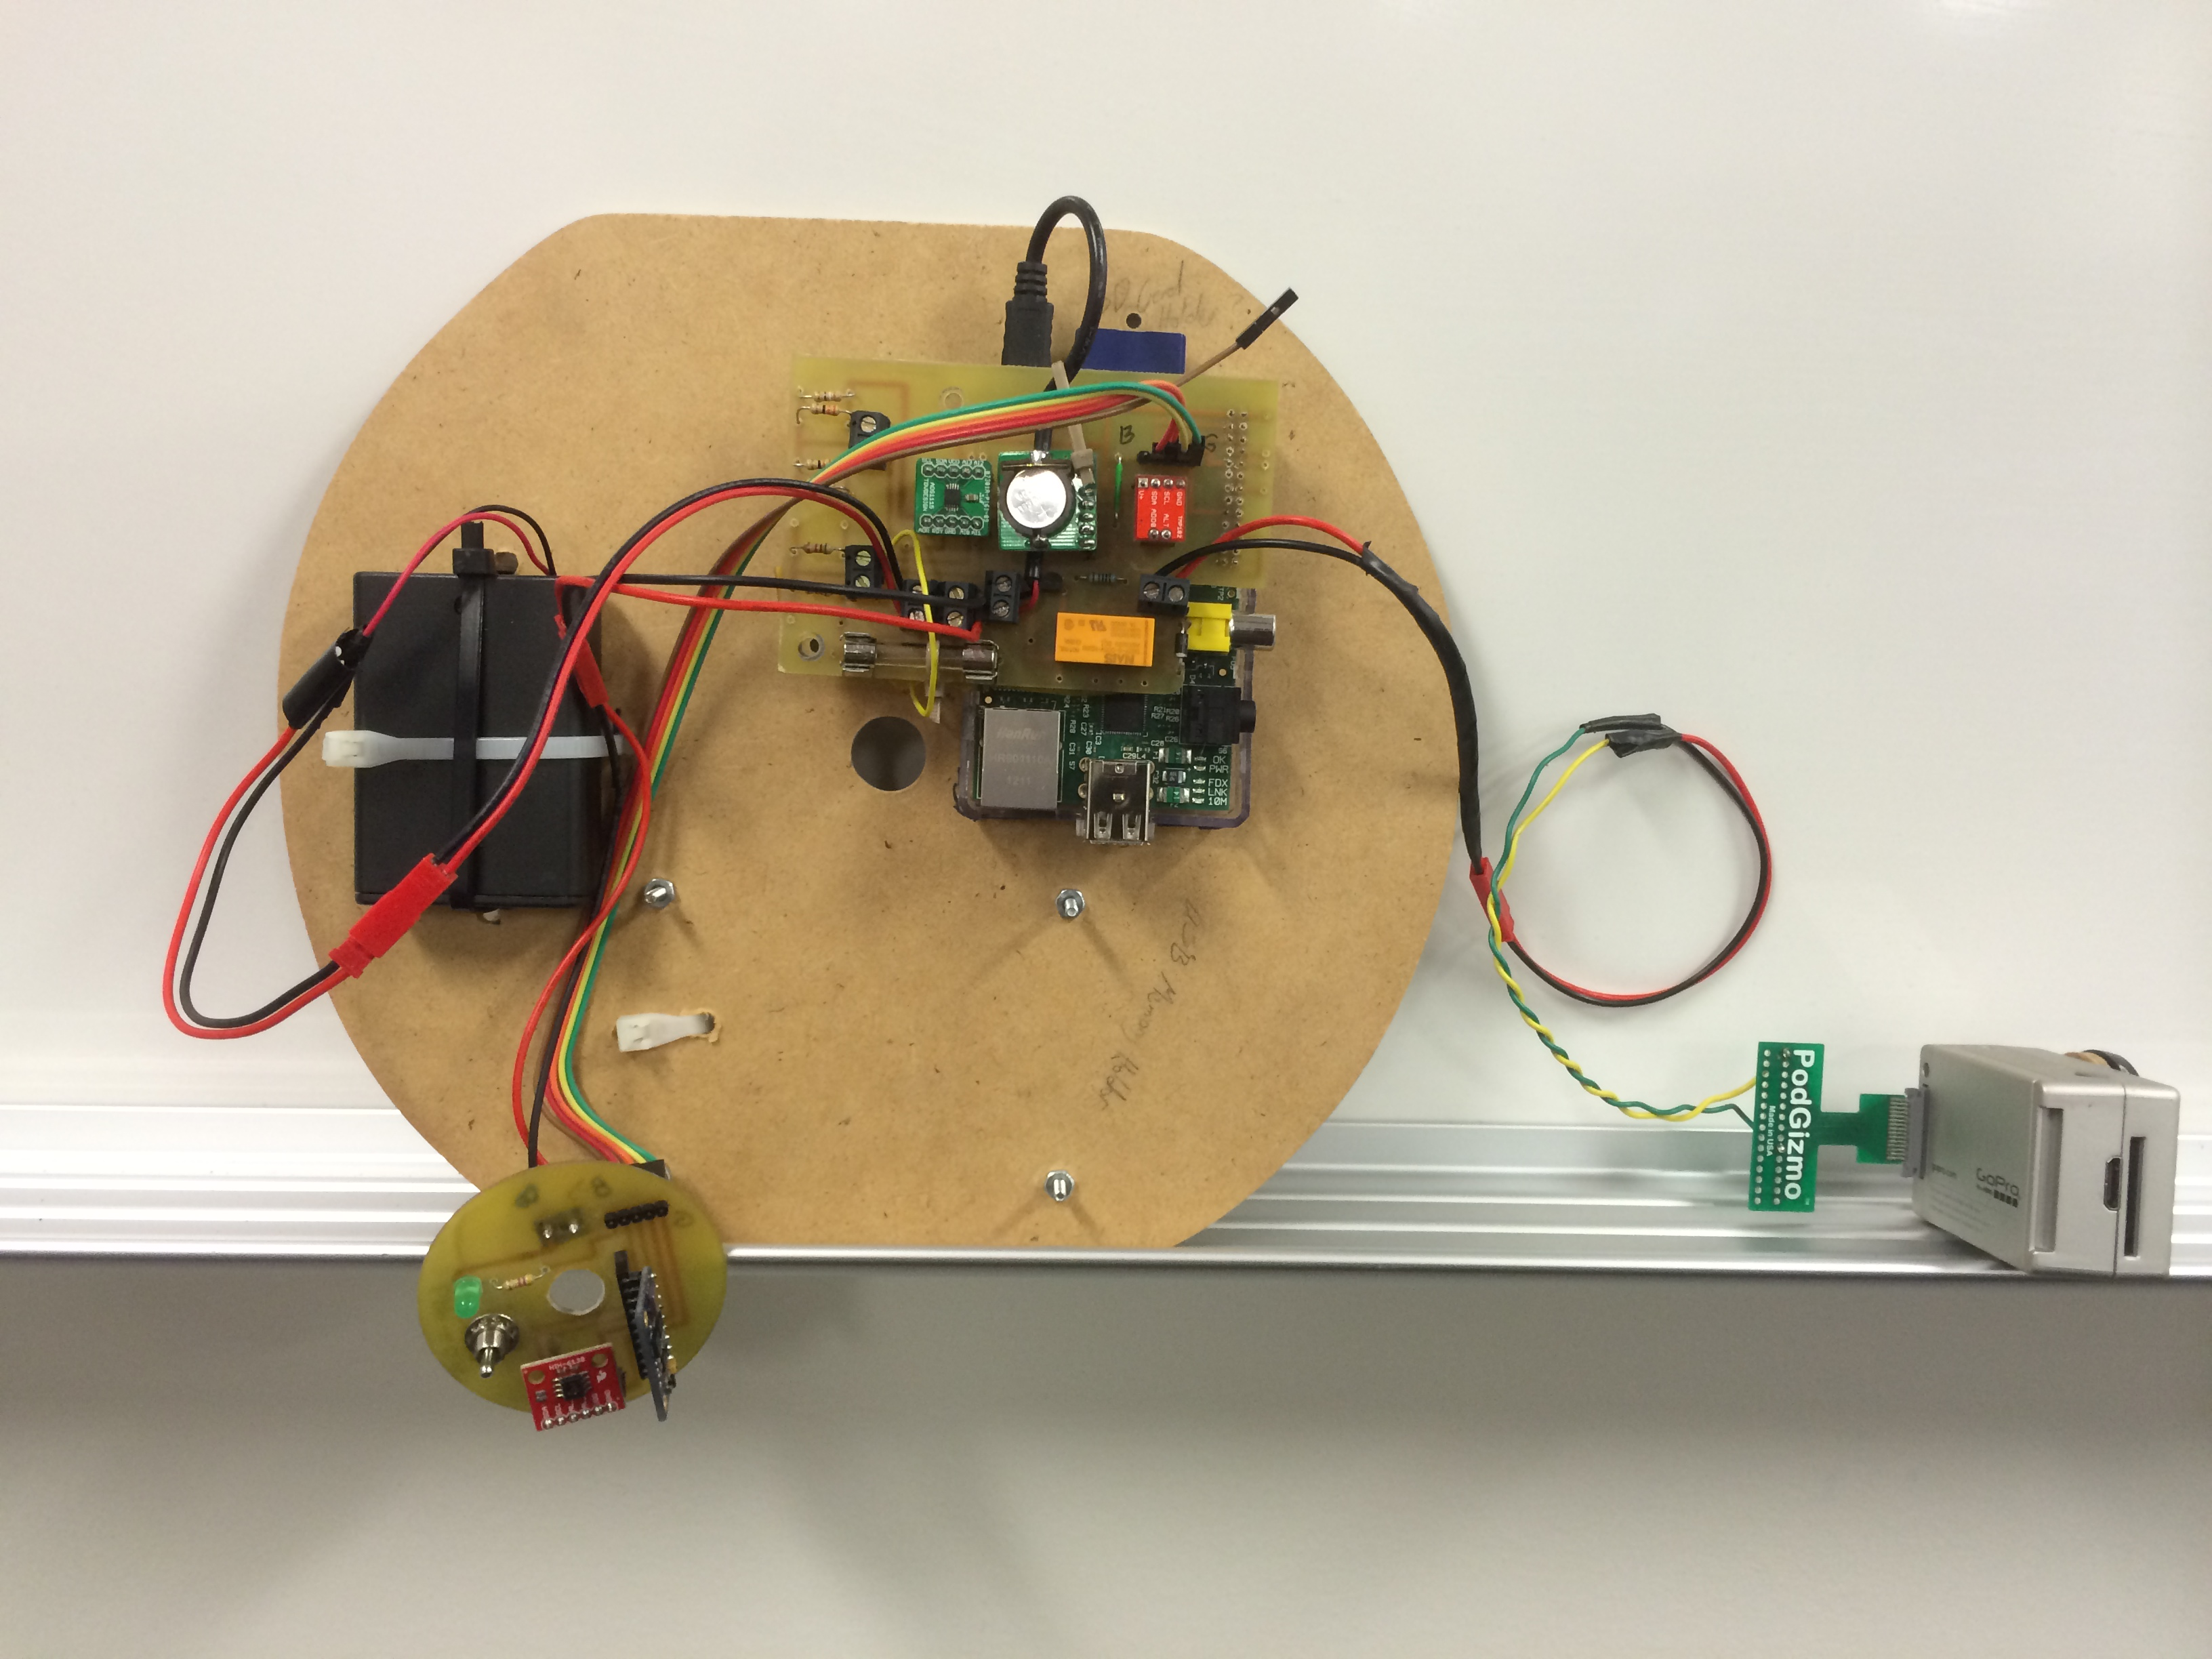
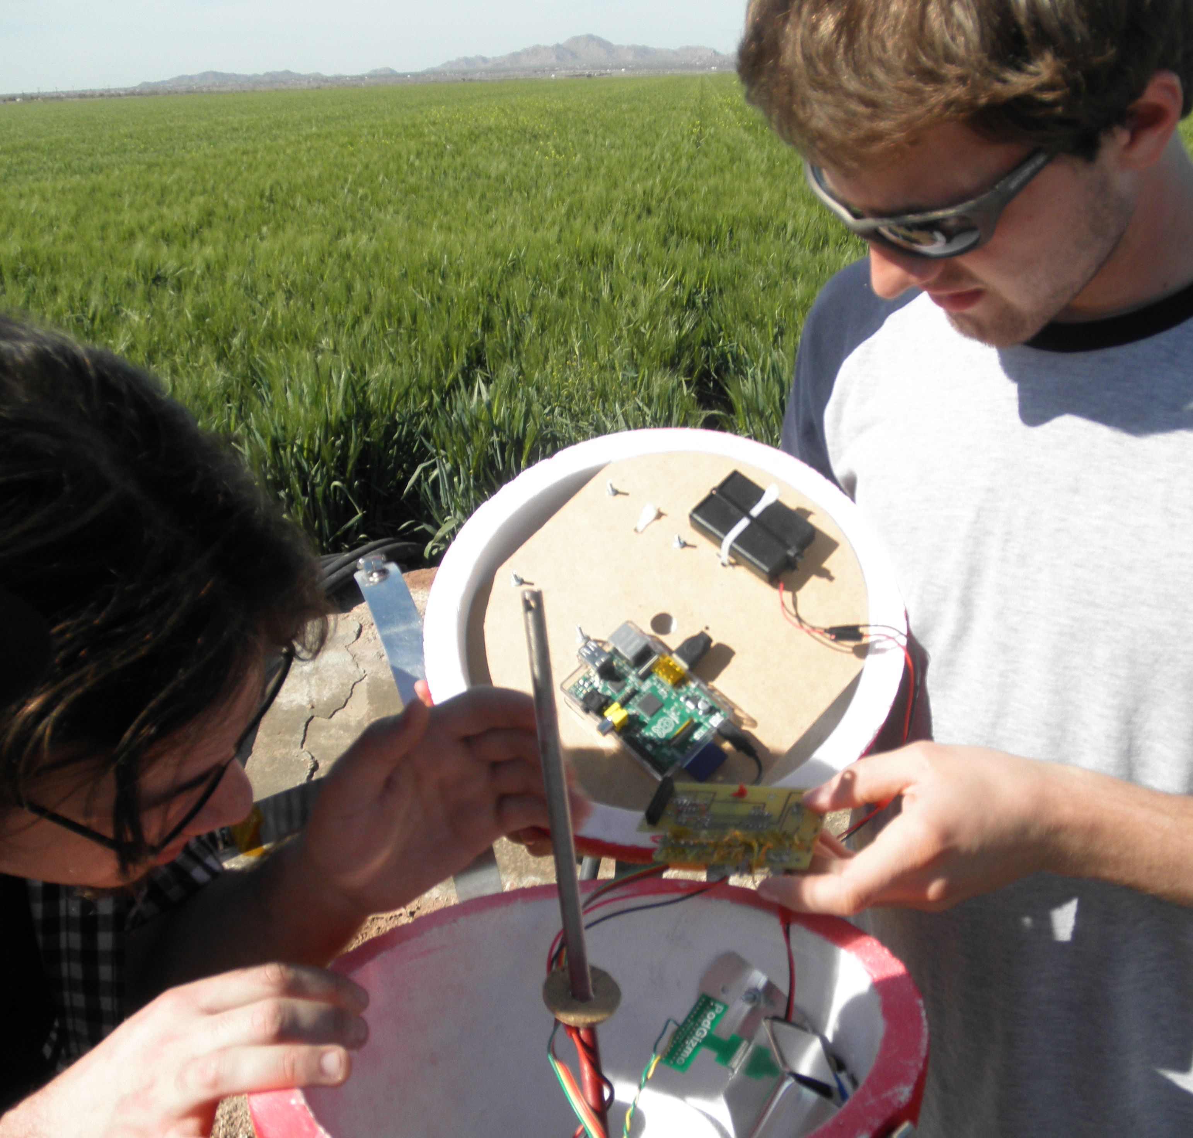
Structure Continued
Board in Center of Capsule

Slide 10
Hardware/Sensors
Raspberry Pi Model B (Processor)
Temperature Sensor
Pressure Sensor
Accelerometer (three axis)
Humidity Sensor
Real Time Clock
Analog to Digital Converter
GoPro Hero 2 Camera
Geiger Counter
Solar Cell

Slide 11
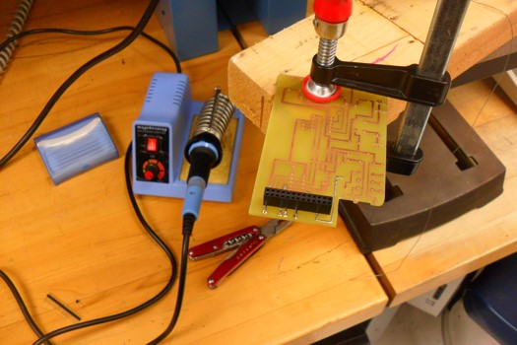
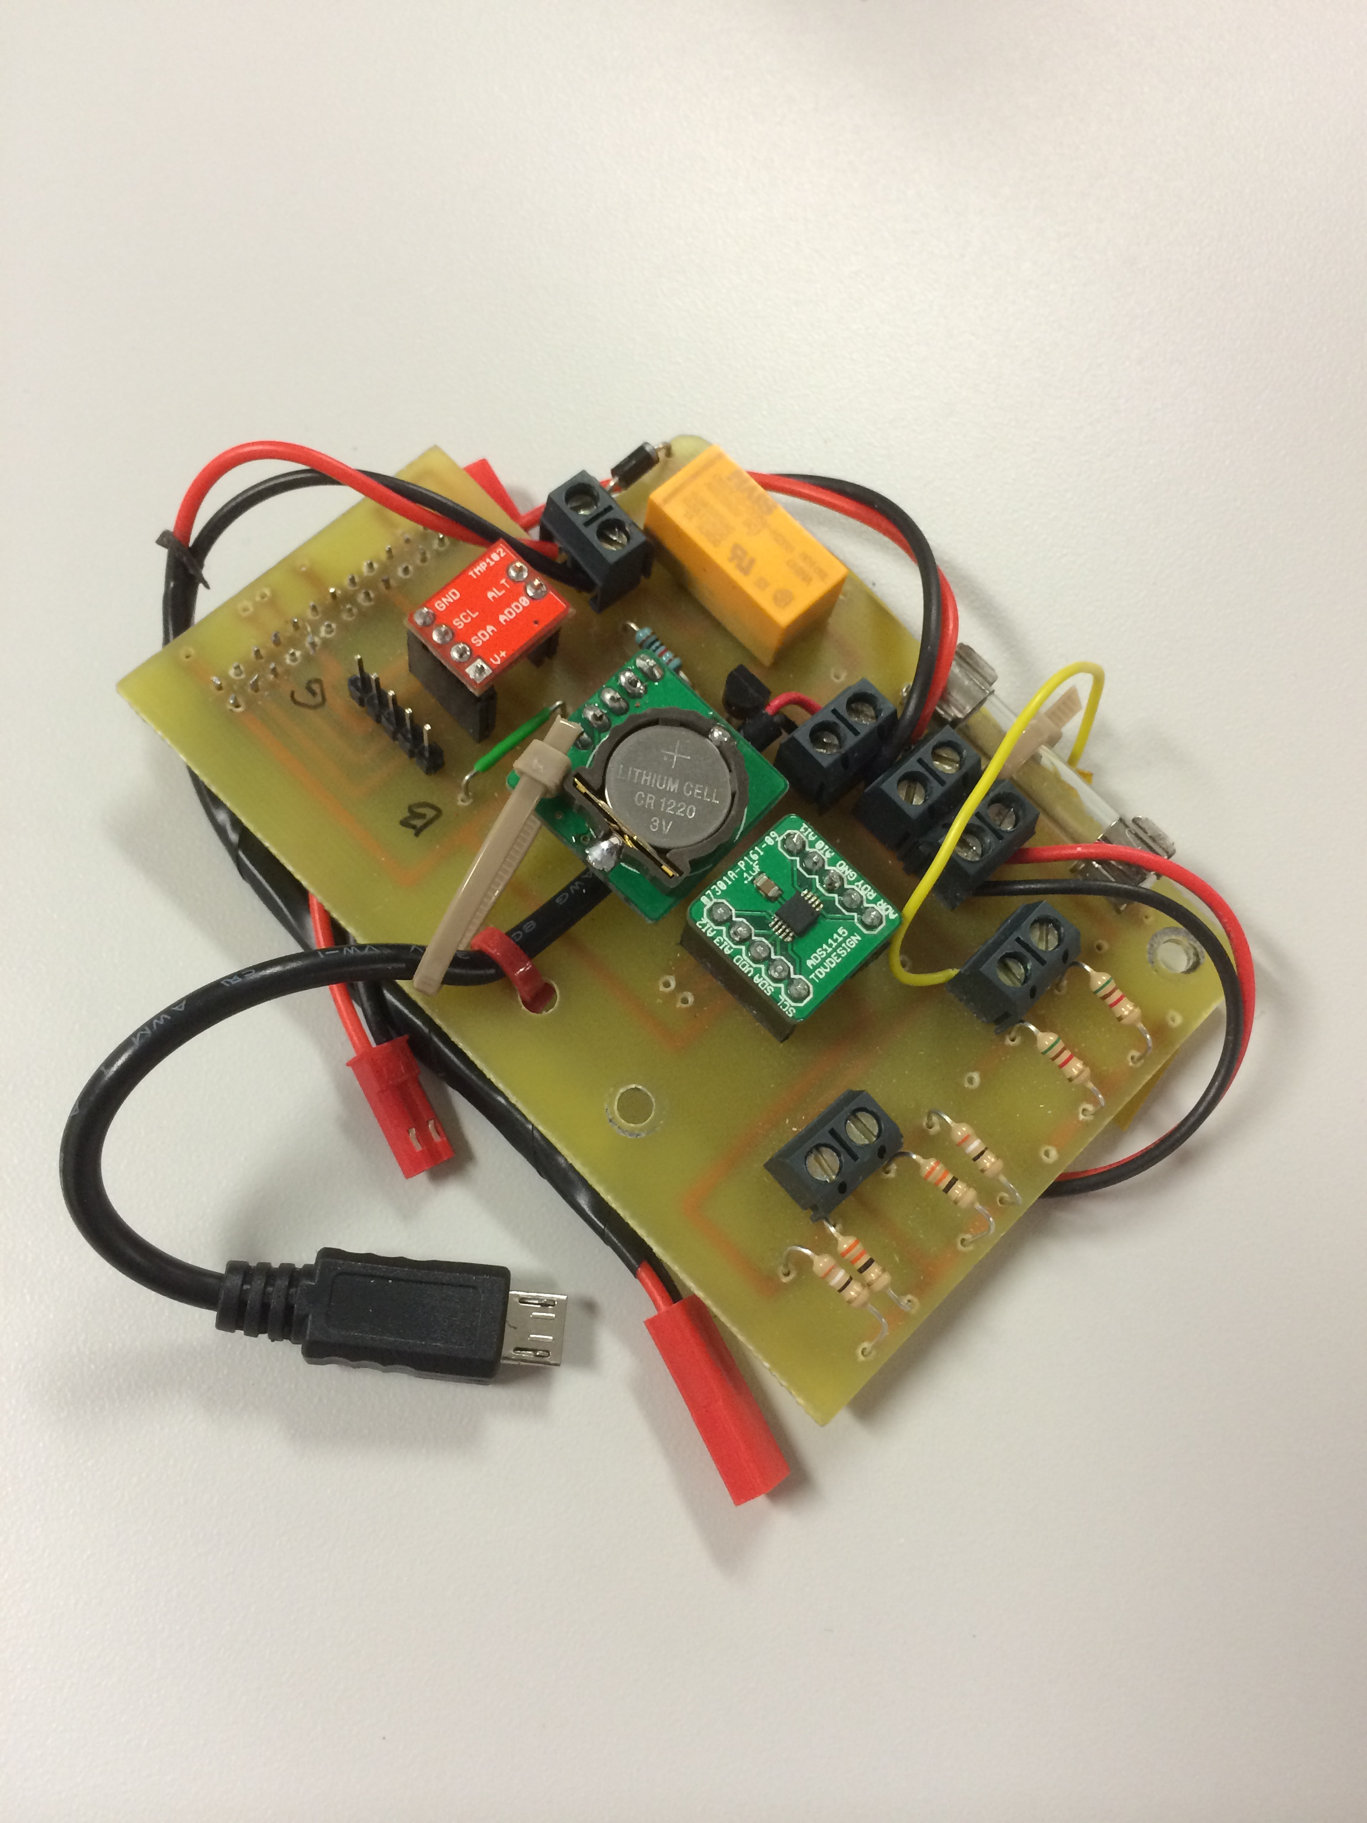
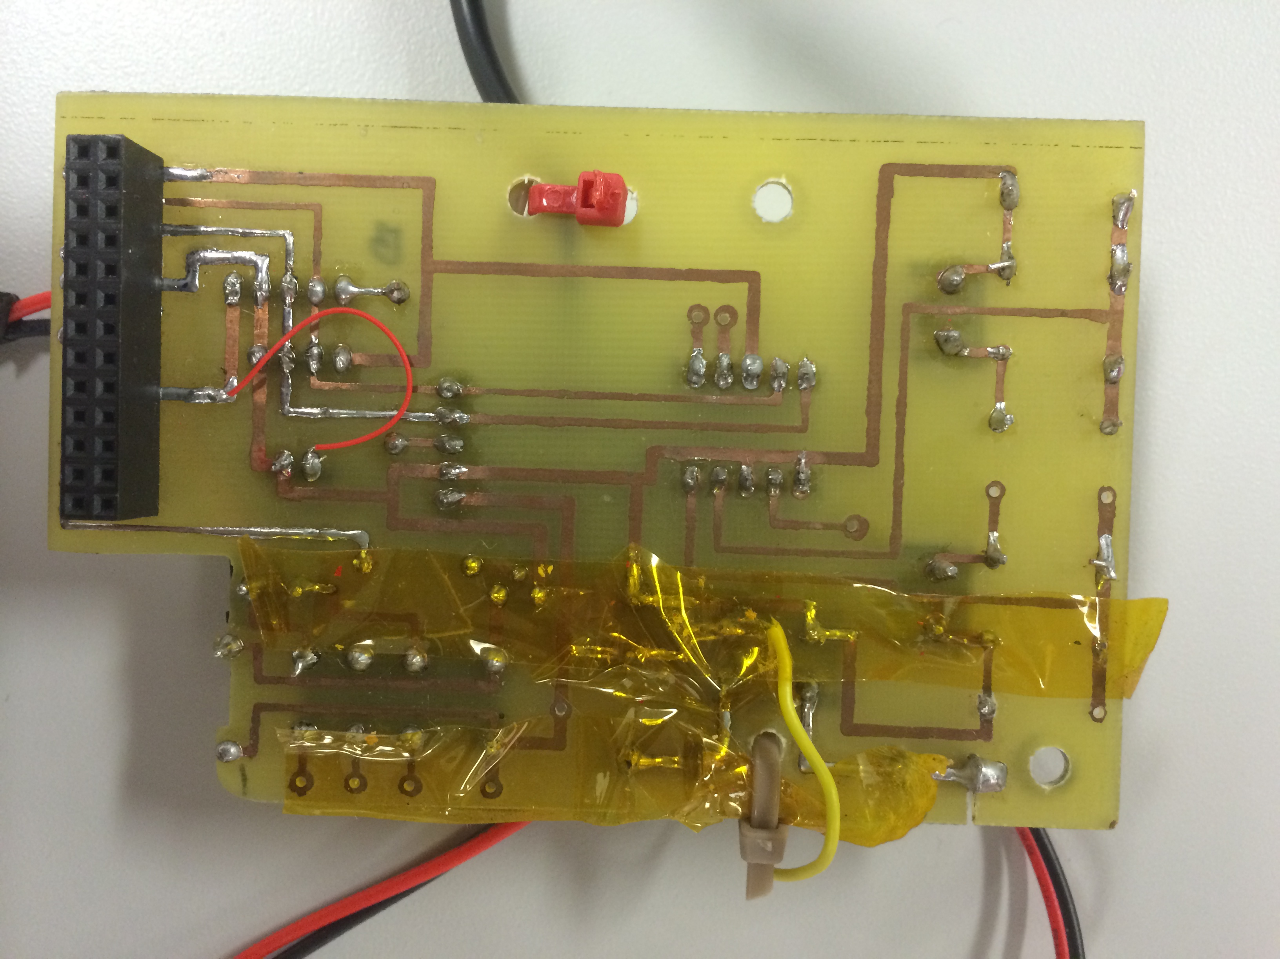
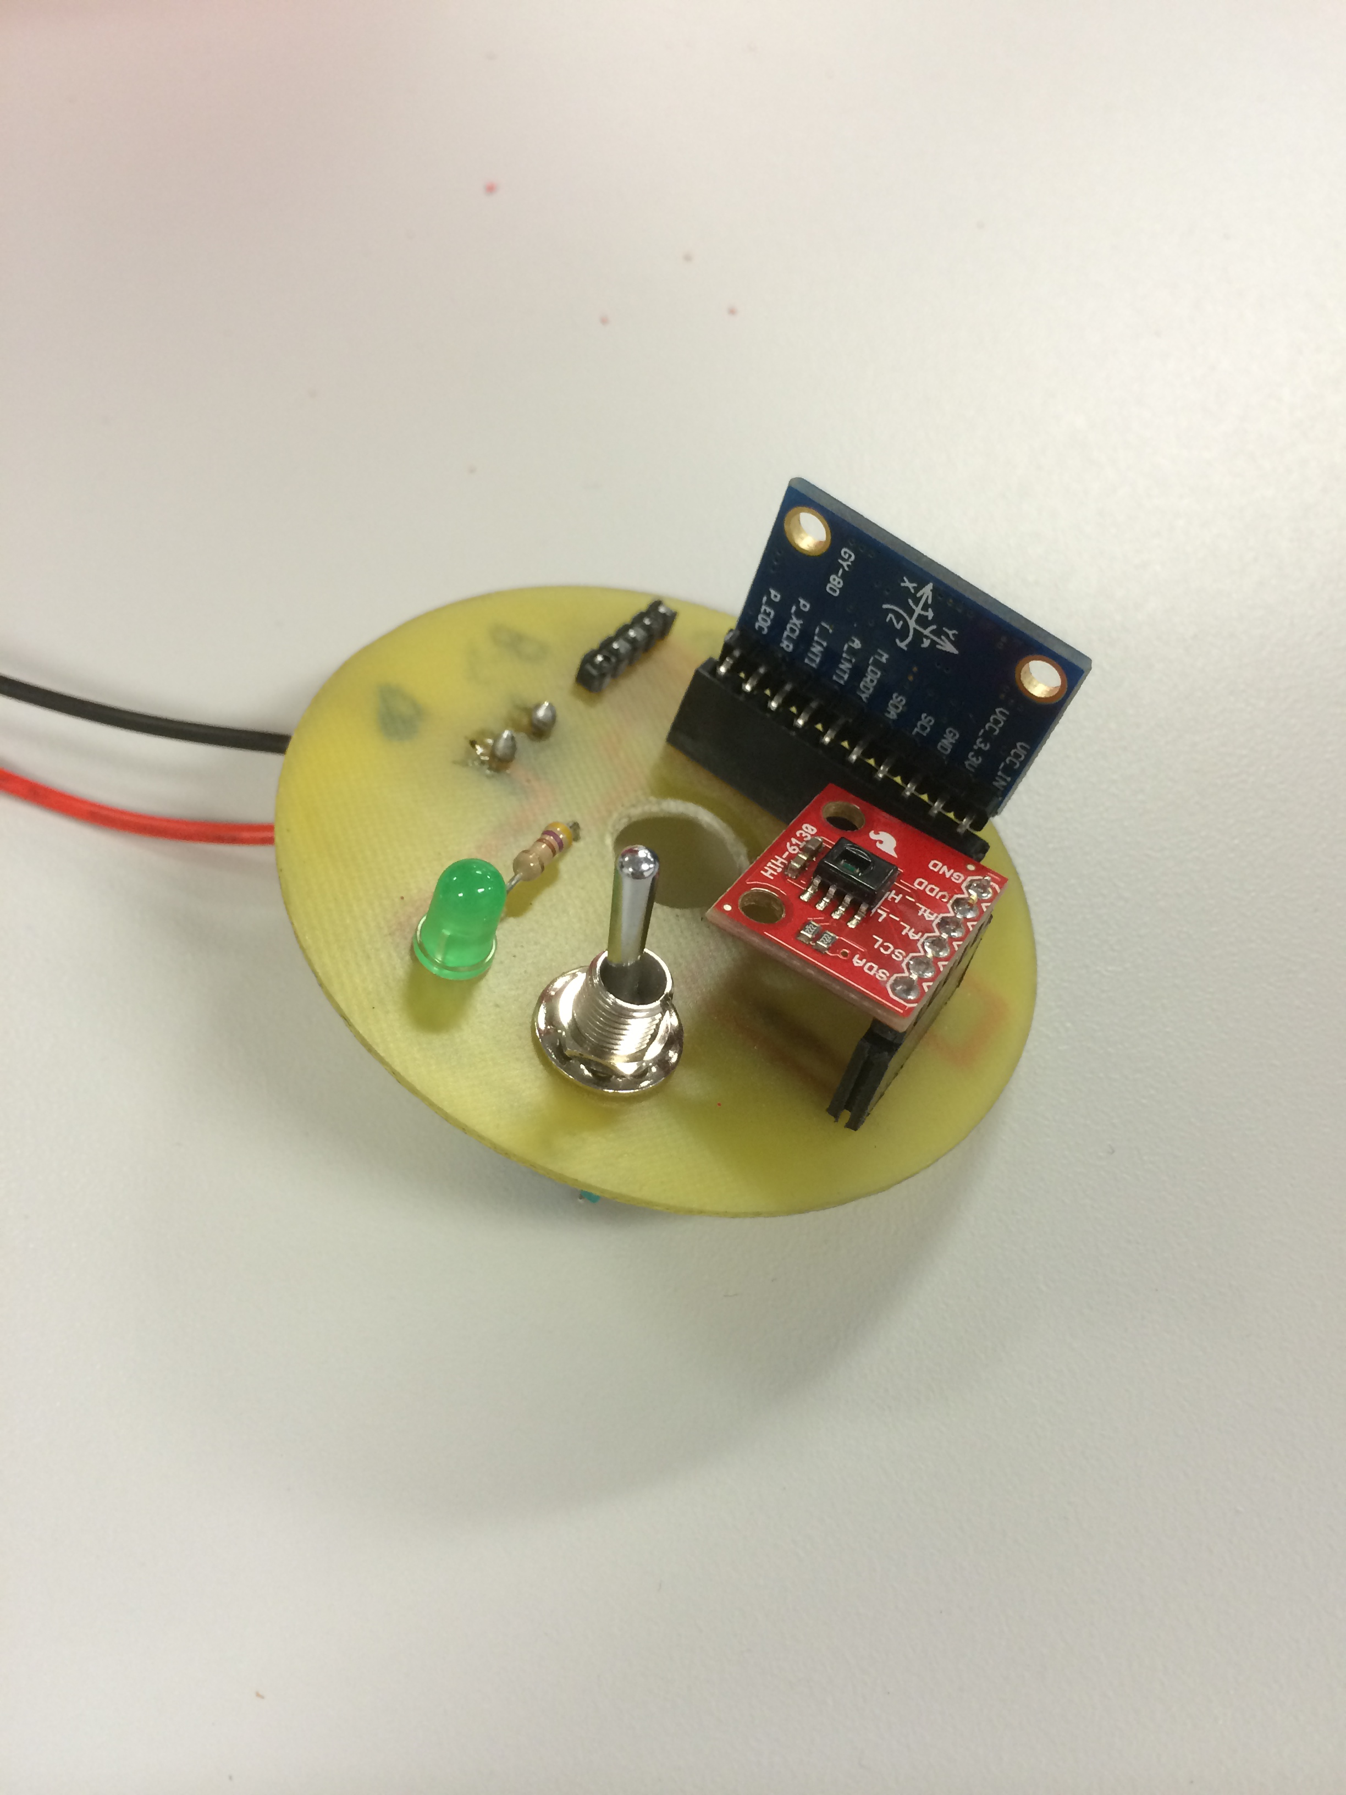
Printed Circuit Boards

Slide 12
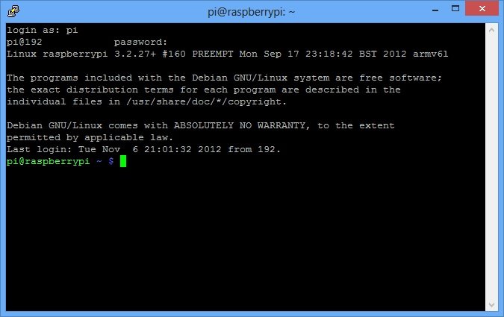
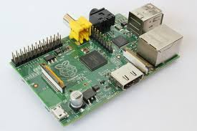
Programming
Reasons for implementing the Raspberry Pi
Writing and programming in a modular format

Slide 13
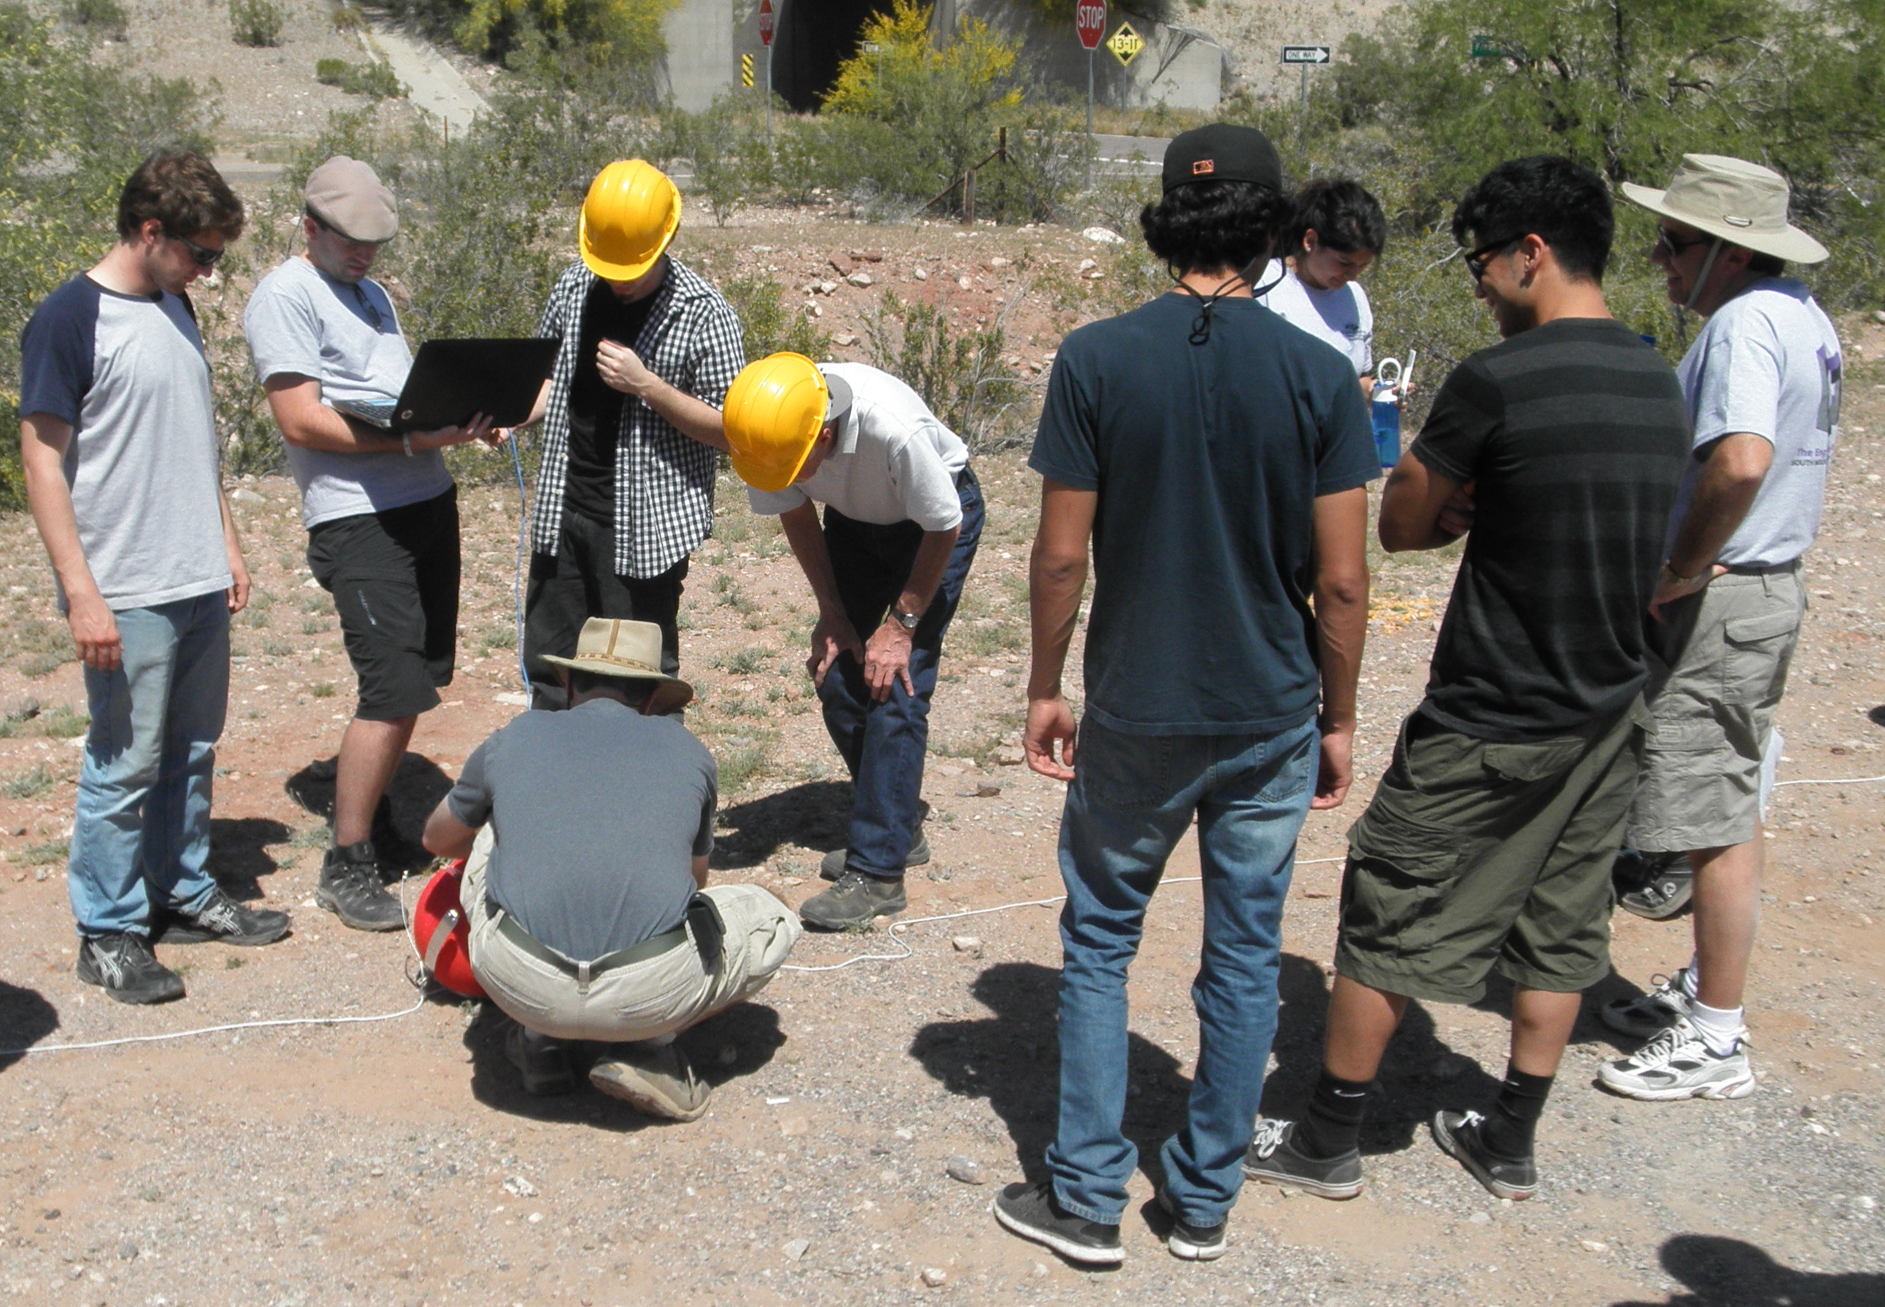
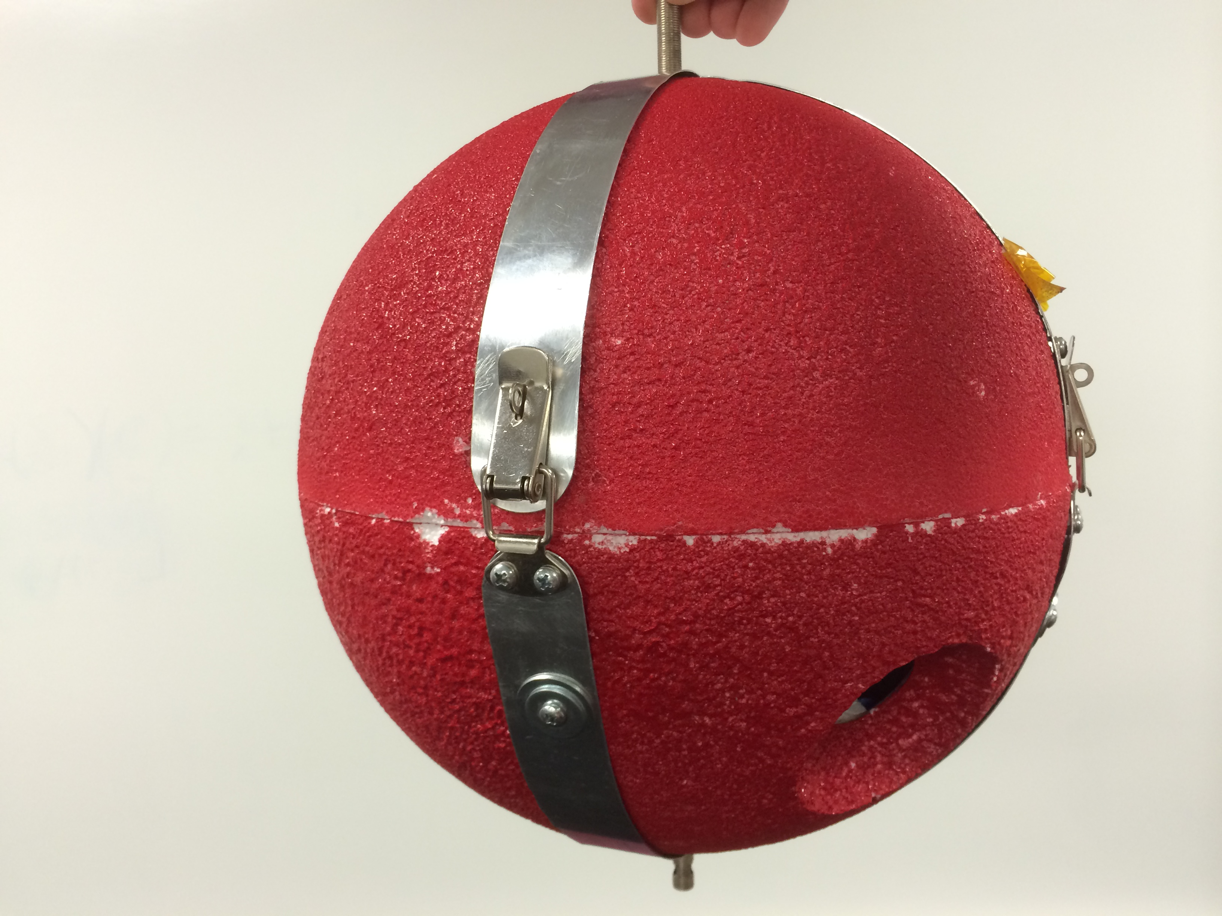
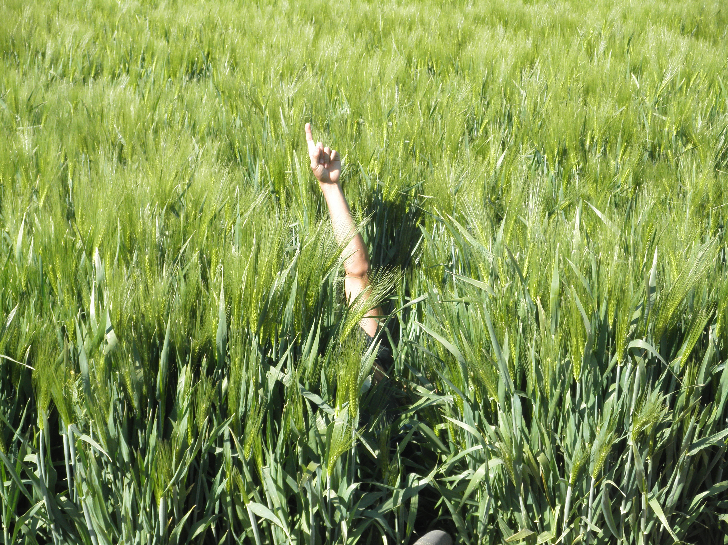
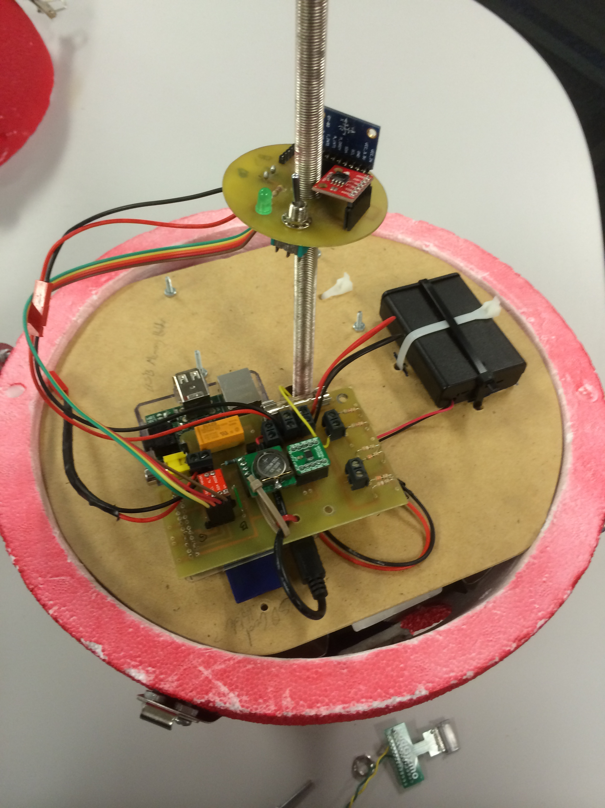
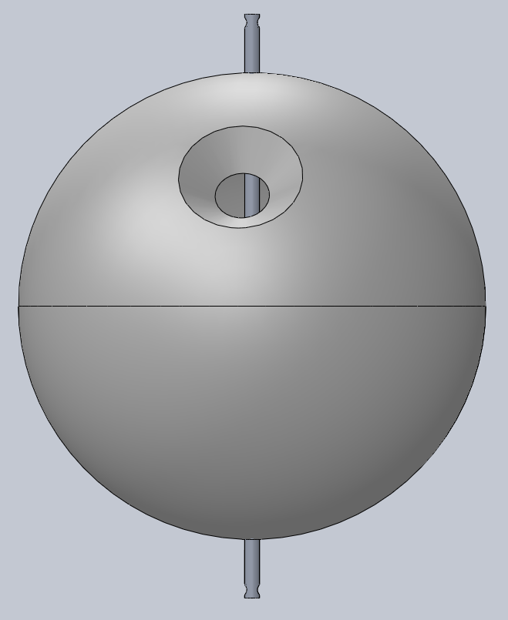

Slide 14
Special Thanks to:
Susan Brew of the Arizona Space Consortium
Jack Crabtree at Arizona Near Space Research
John Schneeg at Glendale Community College

